Slide 1
Digital Humanities (DH)
Introduction

Slide 2
What are the Humanities?
“The humanities—including the study of languages, literature, history, jurisprudence, philosophy, comparative religion, ethics, and the arts—are disciplines of memory and imagination, telling us where we have been and helping us envision where we are going.”
The core of the term humanities is “human” -- thus humanities attempt to understand what it means to be human. Sometimes referred to as classics or liberal arts, the broad field of humanities are studied by “humanists,” the way science is studied by scientists, and art is created by artists.

Slide 3
Humanities covers disciplines outside of the science, technology, engineering, and math (STEM).
Humanities, a definition, https://www.vocabulary.com/dictionary/humanities
Short description and film from the National Humanities Center https://action.nationalhumanitiescenter.org/what-are-humanities/
4Humanities: Advocating for the Humanities: What are the Humanities? https://4humanities.org/2014/12/what-are-the-humanities/
Guide to Issues in Humanities Advocacy https://4humanities.org/guide-to-issues-in-humanities-advocacy/

Slide 4
What are the Digital Humanities?
The Wikipedia entry states, https://en.wikipedia.org/wiki/Digital_humanities:
Digital humanities (DH) is an area of scholarly activity at the intersection of computing or digital technologies and the disciplines of the humanities. It includes the systematic use of digital resources in the humanities, as well as the analysis of their application. DH can be defined as new ways of doing scholarship that involve collaborative, transdisciplinary, and computationally engaged research, teaching, and publishing. It brings digital tools and methods to the study of the humanities with the recognition that the printed word is no longer the main medium for knowledge production and distribution.

Slide 5
More about DH
Digital Humanities (DH) is concerned with applying computational tools to traditional fields in the humanities or liberal arts such as literature, history, and philosophy.
DH, originally known as Humanities Computing, was conceived in the late 1940s and has been practiced ever since.
Implemented by libraries, archives, museums, and other memory institutions in an effort to try to stay relevant.
When the Internet boom began in the mid-90s, all of these institutions realized it was a way for them to reach more people than ever before.

Slide 6
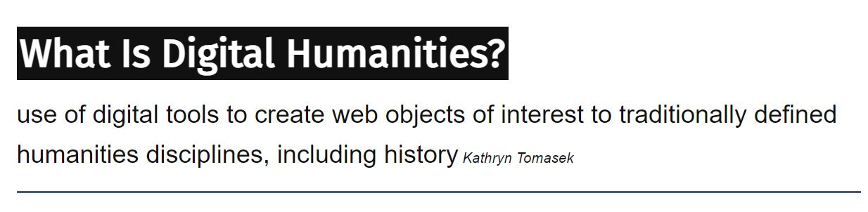
And for less formal answers, take a look at this resource which includes some pithy, some snippy remarks. Each ‘refresh’ provides a new definition.
Note, this in itself is a DH project!
https://whatisdigitalhumanities.com/

Slide 7
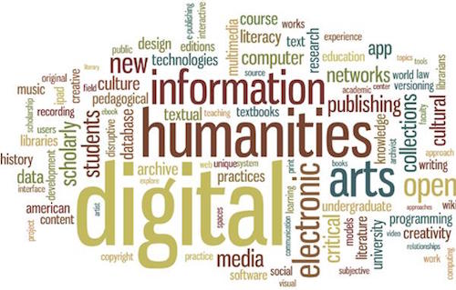
DH Discussion
Why did institutions like museums latch onto this idea so quickly?
What were the benefits and possible negative aspects to this?

Slide 8
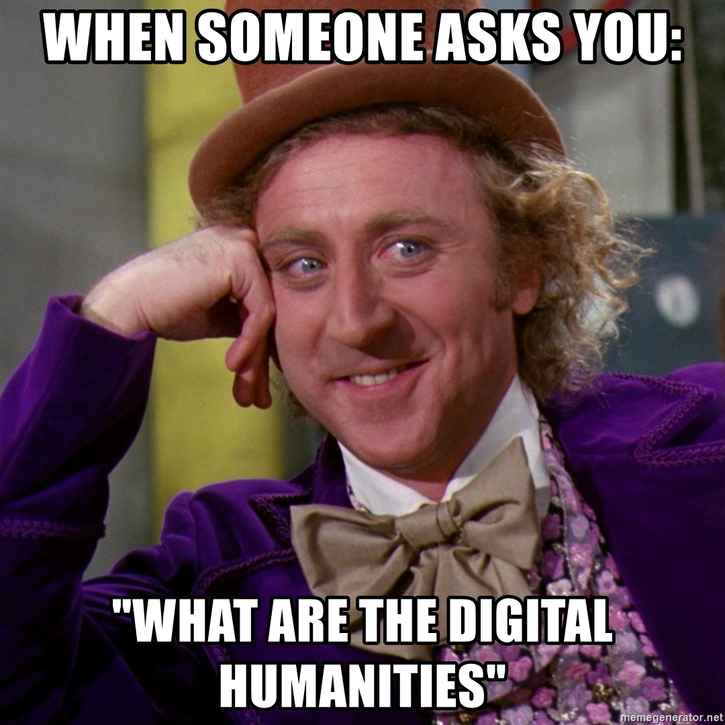

Slide 9
